Slide 1
Strategic Management
Module-II

Slide 2
CORPORATE STRATEGY
MBA205
EXTERNAL ASSESSMENT
The process of performing an external audit, Nature of an external audit,
key external forces,
industry analysis, competitive forces,
competitive analysis- porter’s five forces model,
key success factors.

Slide 3
What is industry analysis?
Industry analysis is the process of evaluating an industry’s current state and future outlook.
It involves examining the industry’s characteristics, competition, growth trends, key success factors, and overall attractiveness to understand profit potential.

Slide 4
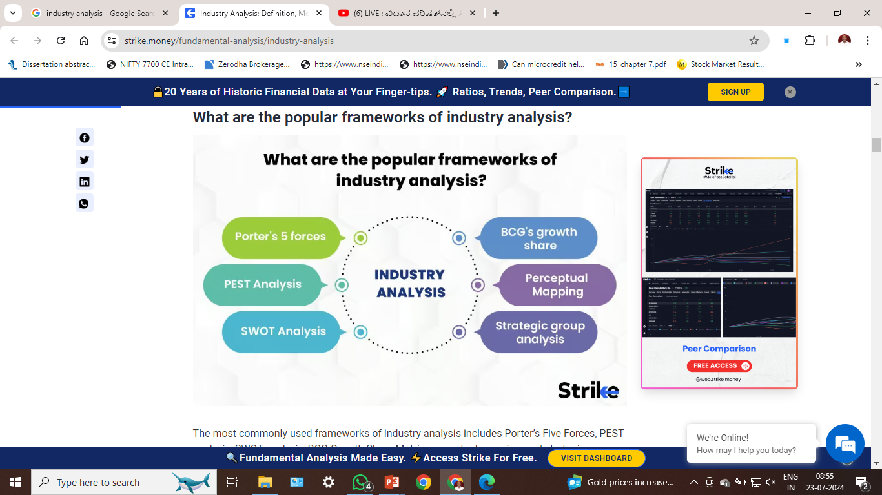


Slide 5
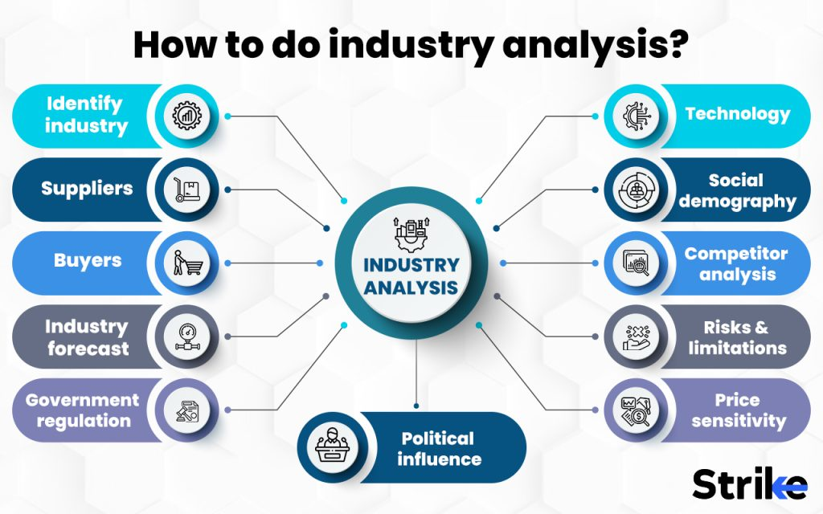

Slide 6
What is industry analysis?
Key steps include
defining the industry and analyzing its structural characteristics like the
life cycle stage, number and size of competitors, competitive dynamics, regulations, technological change, entry/exit barriers, substitutes, and supplier/buyer power.

Slide 7
What is industry analysis?
The analysis also evaluates size and growth trends, market share, profitability, and competitor strengths and weaknesses.
The end goal is to synthesize findings into an industry outlook that highlights strategic opportunities and threats.
Effective industry analysis provides fact-based insights to guide strategic decisions and investments.

Slide 8
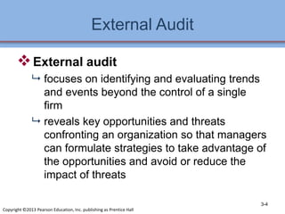

Slide 9
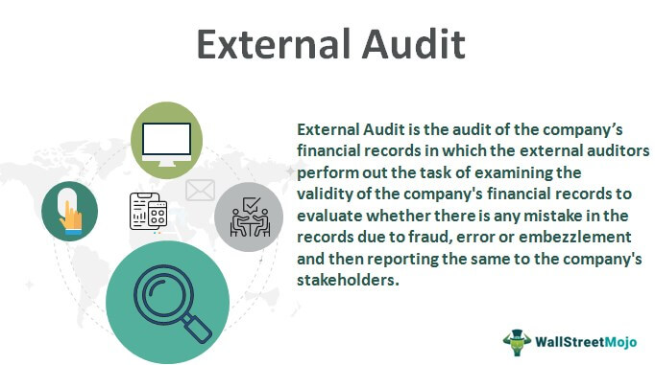

Slide 10
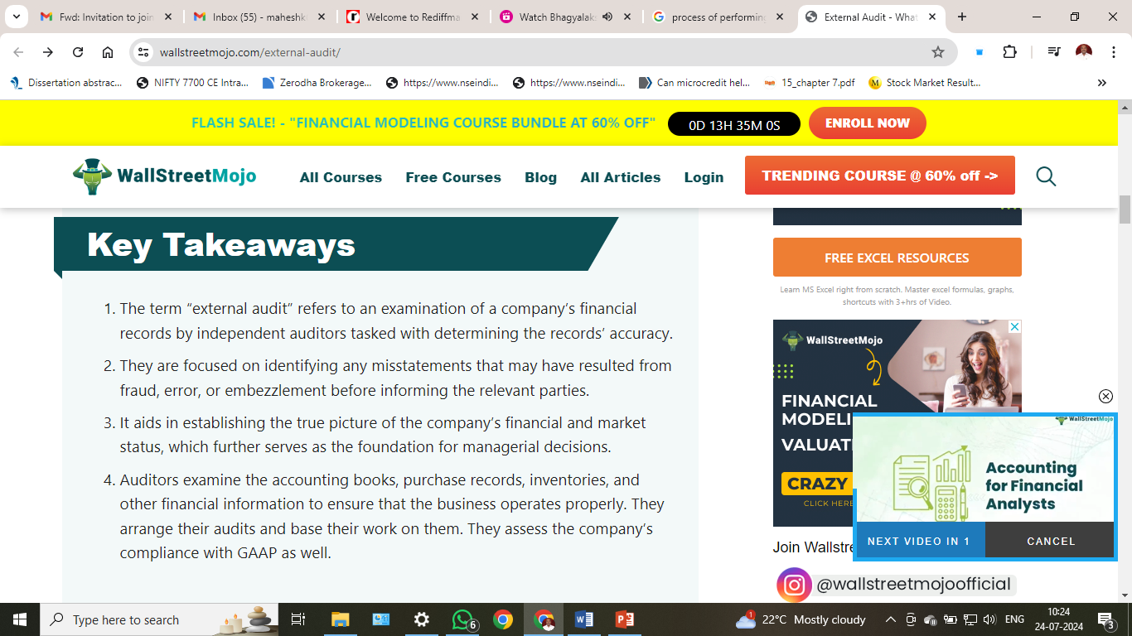

Slide 11
External audit is the process of examination and analysis of the company’s financial documents by an auditor or a team of auditors, external to the company.
These audits are conducted to ensure there are no cases of fraud, embezzlement, or genuine errors from individuals within the company.

Slide 12
The main purpose for which the external audit is conducted includes the determination of the completeness and accuracy of the accounting records of the client.
To ensure that the records of the clients are prepared as per the accounting framework which applies to them.

Slide 13
To ensure that the financial statements of the client present the true and fair results and the financial position.
A statutory auditor can ask for the company’s financial books, records, or information in relation to that for which the management cannot deny him.

Slide 14
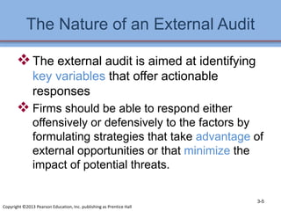

Slide 15
External Audit Process
PlanningThe auditor discusses with the organisation to be audited the scope of the audit, the areas to be audited and the desired results. An audit plan is drawn up that specifies the individual steps and the time frame for the audit.
Data collectionThe auditor collects relevant information, documents and data from the organisation to be audited. This may include reviewing financial records, business processes, internal control systems and other relevant information.

Slide 16
External Audit Process
Planning
Data collection
Audit procedures
Evaluation
Reporting
Follow-up action

Slide 17
External Audit Process
Audit procedures The auditor performs various audit procedures to verify the accuracy, completeness and reliability of the information. This may include interviews with staff, on-site inspections, conducting tests and analysis.
EvaluationThe auditor evaluates the information gathered and compares it with applicable standards, guidelines or legal requirements. Possible deviations or irregularities are identified and documented.

Slide 18
External Audit Process
Reporting The auditor prepares an audit report summarizing the results of the audit. This report usually contains a description of the audit procedures performed, the deviations or irregularities identified and recommendations for improving processes or compliance with standards.

Slide 19
External Audit Process
Follow-up action- Based on the results of the audit, the audited organisation may take action to address the identified deficiencies or implement improvements. The auditor may also conduct a follow-up audit to verify that the recommended actions have been implemented.
It is important to note that external audits can be conducted in a variety of areas, including financial audits, ISO certification audits, IT security audits and environmental audits. The exact process may vary depending on the type of audit and the standards and regulations involved.

Slide 20
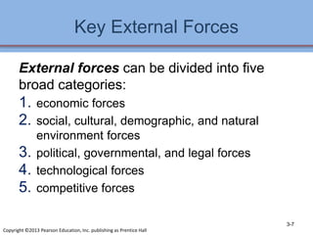

Slide 21
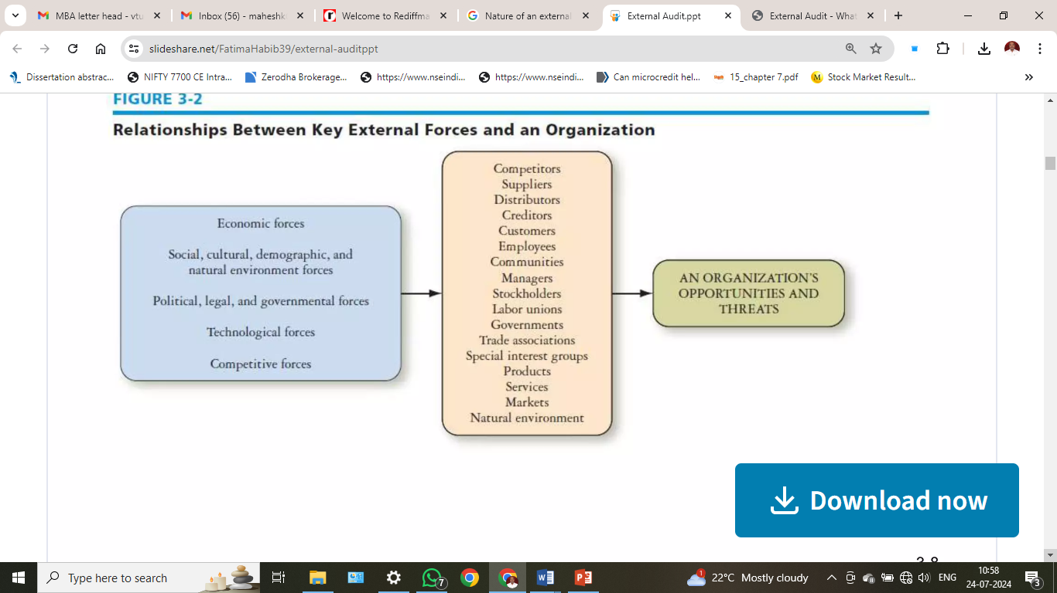

Slide 22
Terms and Concepts
Environmental uncertainty:
The degree of complexity plus the degree of change existing in an organization’s external environment.
Environmental scanning:
The monitoring, evaluating, and disseminating of information from the external and internal environments to key people within the corporation to avoid strategic surprise and ensure the long-term health of the firm.
Industry defined:
A group of firms producing a similar product or service, such as soft drinks or financial services.

Slide 23
The External Environment
Societal environment (Macro):
General forces that do not directly touch on the short-run activities but often influence its long-run decisions.
Task environment (Industry):
Those elements or groups that directly affect the corporation and, in turn, are affected by it. The task environment is the industry within which that firm operates.

Slide 24
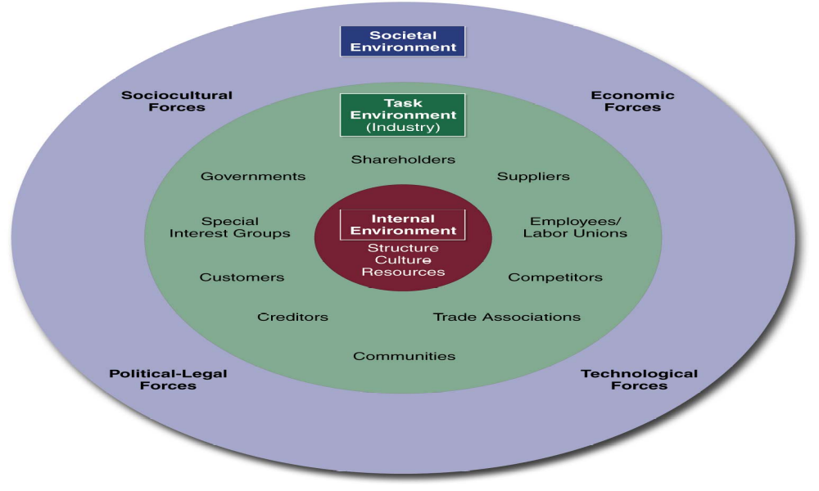
The External Environment

Slide 25

Operating Environment
Economic Factors
  Intense growth – dependent on machines
  Demand for product services & support
Social Factors
  Wireless communication
  Powerful & portable devices
Political Factors
  Copyrights protection
Technological Factors
  Strong rivalries among top competitors
  Continuously changing products
Ecological Factors
  Pollution
  Corporate Social Responsibility
Summary
  Product support services
  Powerful & portable devices

Slide 26
company’s macro environment includes all relevant factors and influences outside the company’s boundaries;
by relevant, we mean important enough to have bearing on the decisions the company ultimately makes about its direction, objectives, strategy, and business model.

Slide 27
The factors and forces in a company’s macro environment having the biggest strategy-shaping impact almost always pertain to the company’s immediate industry and competitive environment.

Slide 28
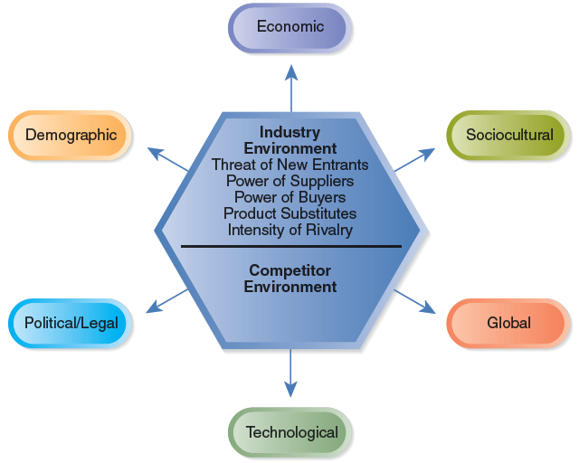
The External Environment

Slide 29
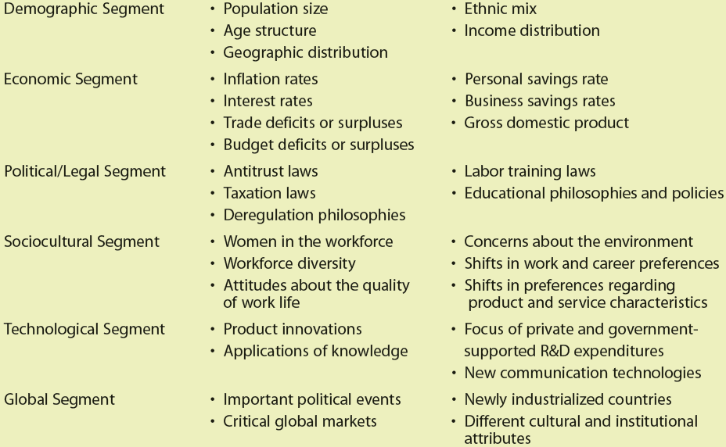
The General Environment: Segments and Elements

Slide 30
Components of the External Environmental Analysis
Scanning • Identifying early signals of environmental changes and trends
Monitoring • Detecting meaning through ongoing observations of environmental changes and trends
Forecasting • Developing projections of anticipated outcomes based on monitored changes and trends
Assessing • Determining the timing and importance of environmental changes and trends for firms’ strategies and their management

Slide 31
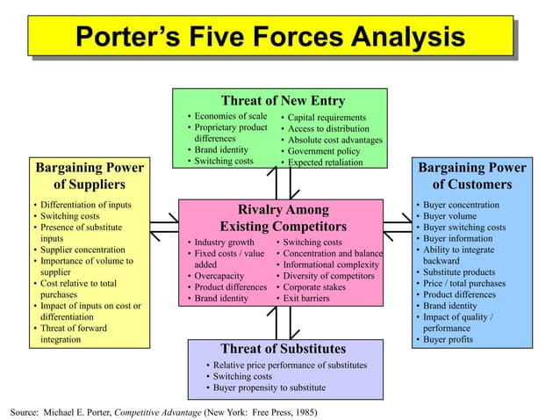

Slide 32
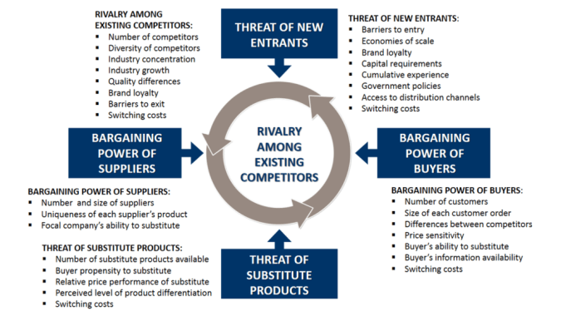

Slide 33
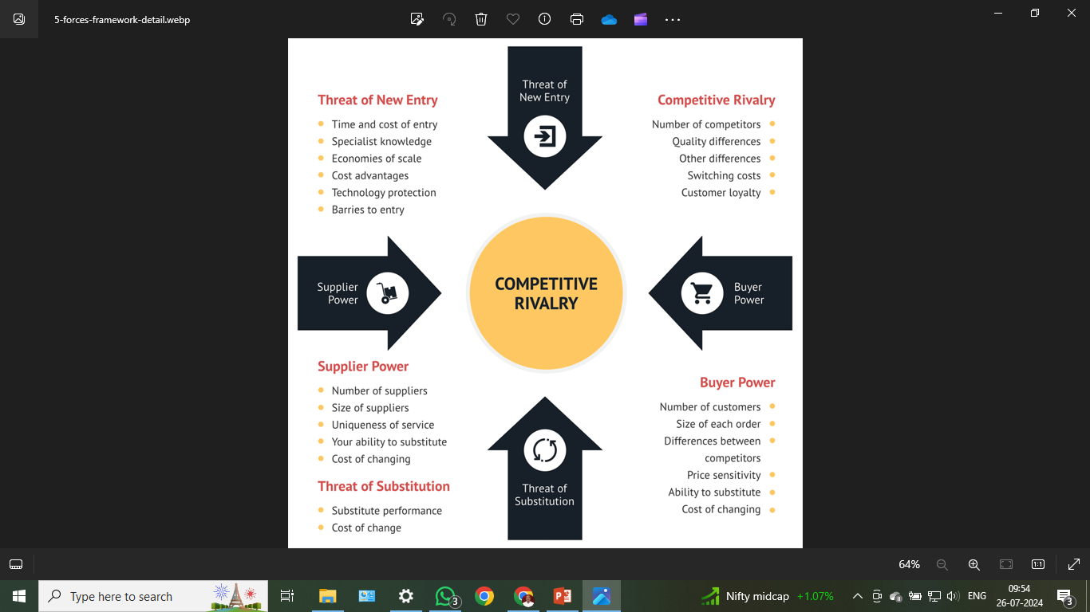

Slide 34
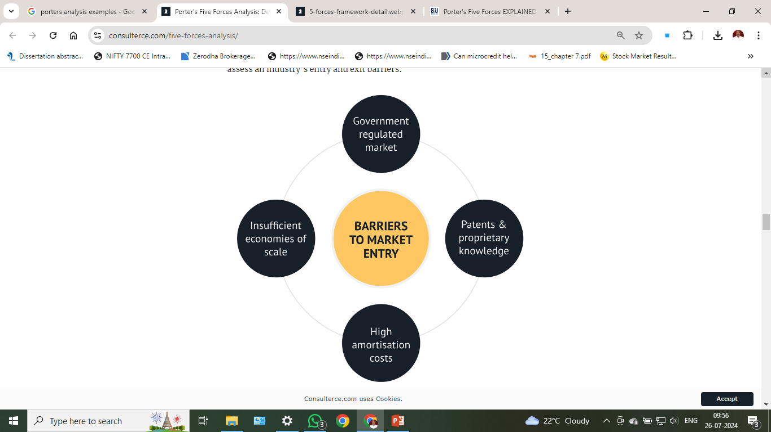

Slide 35
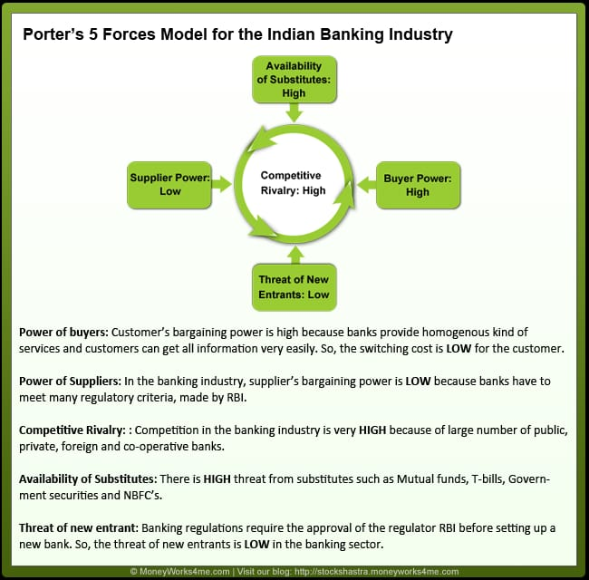

Slide 36
Economy
Growing vs. shrinking economies
Future economic activity is difficult to predict
Business confidence indices
  show how confident managers are about future organizational growth

Slide 37
Application of Industry Analysis Model
Define the industry
Identify the key players
Assess the strategic strengths
Identify the factors you have some control over
Evaluating the competitive forces:
Analyze the industry structure

Slide 38
Applying the Model
Define the industry: The process begins with a clear description of the industry, helping you to focus your analysis.
Identify the key players: Specify and group the major actors in the sector into strategic categories based on relevant criteria.
Assess the strategic strengths: This means evaluating the firm and its industry to determine the better and worse strategies that can be applied.

Slide 39
Analyze the industry structure: This involves examining the overall structure of the industry, particularly the factors that influence how profitable it is.
Evaluating the competitive forces: assessing their positive and negative effects, and then looking forward to any changes in these forces ahead.
Identify the factors you have some control over: pinpoint aspects of the industry structure that could be influenced by competitors, new market entrants, or your firm. In sum, what can be changed?

Slide 40
Technological Component
Product innovations
Applications of knowledge
Focus of private and government-supported R&D expenditures
New communication technologies

Slide 41
Technological Component
Information
Output - Input
Technology-- Knowledge
Tools & Techniques
Raw Materials
Services
Products

Slide 42
Socio cultural Component
Sociocultural Components
  Demographic changes
  Changes in behavior, attitudes, and beliefs
Growing Trends
Decreased number of new births
Overcrowding in inner cities and surrounding counties
Decreased funding for community based organizations
Conservative governmental administrations
Growing Latino and Asian Pacific Islander populations in region and nation.

Slide 43
Socio cultural Component
Women in the workplace
Workforce diversity
Attitudes about quality of work life
Concerns about environment
Shifts in work and career preferences
Shifts in product and service preferences

Slide 44
Political / Legal
Legislation
Regulations
Court decisions
Organizations must be educated about the laws, regulations, and potential lawsuits that could affect organization

Slide 45
Specific Environment
Consumers
Competitors
Funders
Regulations
Advocacy groups

Slide 46
Competitor Component
Competitive Analysis
Deciding who your competitors are
Anticipating competitors’ moves
Determining competitors’
strengths and weaknesses

Slide 47
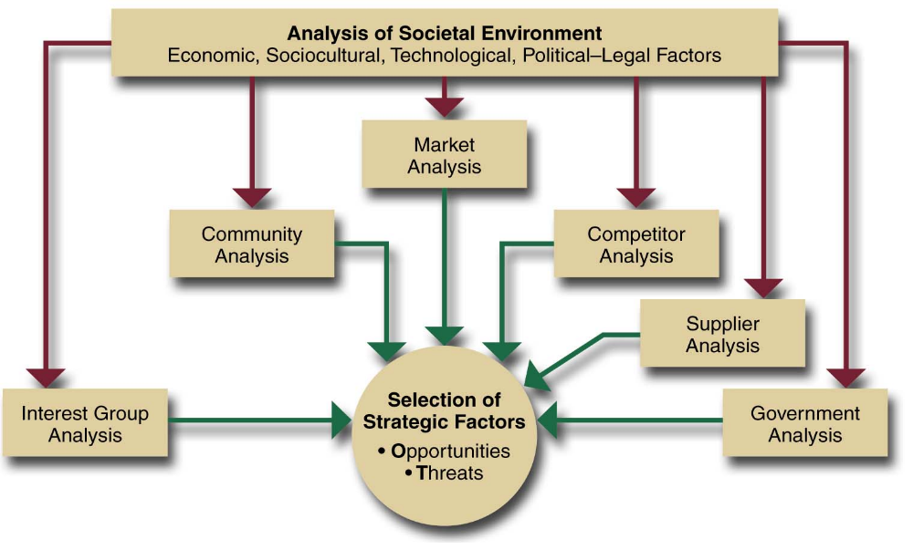
Industry analysis
An in-depth examination of key factors within a corporation’s task environment

Slide 48
Thinking Strategically About a Company’s Industry and Competitive Environment
  Identifying Strategically Relevant Industry Features
  Analyzing the Nature and Strength of Competitive Forces
  The Drivers of Change: What Impacts Will They Have?
  Diagnosing the Market Positions of Industry Rivals
  Predicting the Next Strategic Moves Rivals Are Likely to Make
  Pinpointing the Key Factors for Future Competitive Success

Slide 49
The Organization and Its Environments
International
Technological
dimension
dimension
Competitors
Regulators
Owners
Customers
Employees
Physical environment
Board of directors
Culture
Political-
Economic
legal
Strategic
dimension
dimension
partners
Suppliers
Internal environment
Sociocultural
dimension
Task environment
External
environment
General environment

Slide 50
The External Environment
The General Environment
  Economic dimension is the overall health and vitality of the economic system in which the organization operates.
  Technological dimension refers to the methods available for converting resources into products or services.
Notes:
7

Slide 51
The External Environment (cont’d)
The Task Environment
  Specific groups affecting the organization
    Competitors seeking the same resources as the organization.
    Customers who acquire an organization’s products or resources.
    Suppliers that provide resources for the organization.
    Regulators (agencies and interest groups) that control, legislate, or influence the organization’s policies and practices.
    Strategic partners (allies) who are in a joint venture or partnership with the organization.
Notes:
9

Slide 52
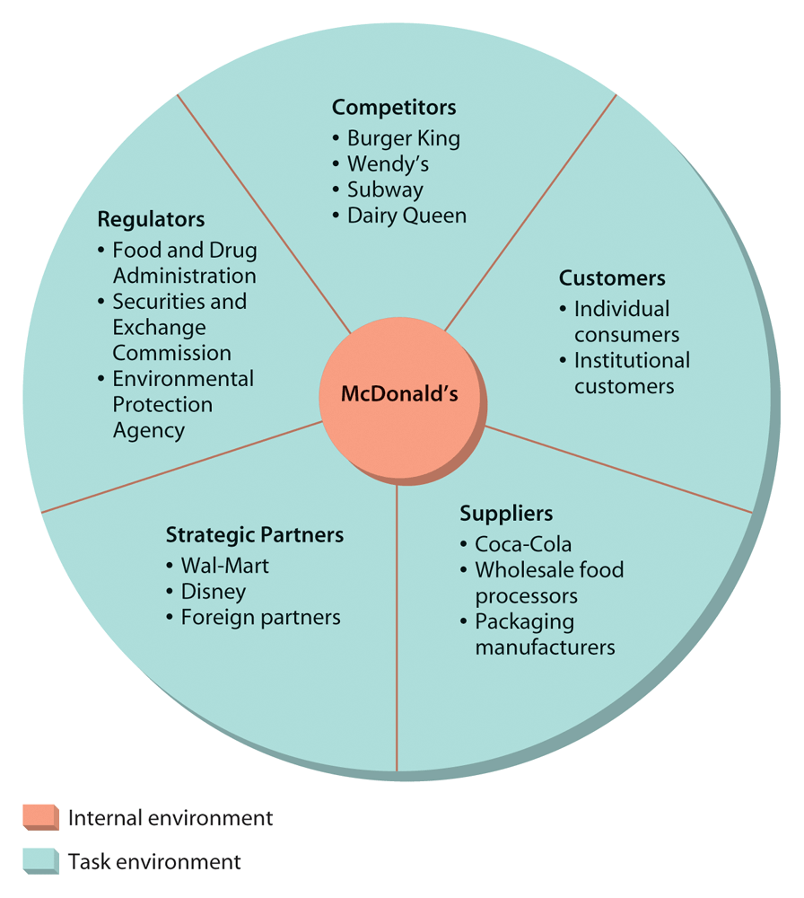
McDonald’s Task Environment

Slide 53
To gain a deep understanding of a company's industry and competitive environment, managers do not need to gather all the information they can find and spend lots of time digesting it. Rather, the task is much more focused.

Slide 54
Societal (Macro) environment forces
Economic forces
  Regulate the exchange of materials, money, energy, and information
Technological forces
  Generate problem-solving inventions
Political-legal forces
  Allocate power, provide laws and regulations
Sociocultural forces
  Regulate values, mores, and customs

Slide 55
External Strategic Factors
Key environmental trends that are judged to have both a medium to high probability of occurrence and a medium to high probability of impact on the corporation.

Slide 56
Industry Analysis
Industry analysis involves reviewing the economic, political and market factors that influence the way the industry develops.
Major factors can include the power wielded by suppliers and buyers, the condition of competitors, and the likelihood of new market entrants.

Slide 57
Industry Analysis:
Industries differ widely in their economic features, competitive character, and profit outlook.
The economic features and competitive character of the trucking industry bear little resemblance to those of discount retailing.
The fast-food business has little in common with the business of developing software for internet applications.

Slide 58
Definition
A market assessment tool designed to provide a business with an idea of the complexity of a particular industry.

Slide 59

Apple Profile
Products: Desktop computers, laptops, digital music players, software
Markets: High-end, technology-savvy users
Size: $8.3 billion in sales in 2004
Industry:
  Key Players:
    Dell
    Hewlett-Packard
    Microsoft
  Keys to success:
    Innovation
    Quality support services

Slide 60

Apple’s Mission & Vision
Mission: Apple is in the business of innovating, manufacturing, and marketing/selling computer hardware and software solutions, related peripherals, and communications equipment.
Vision:
  To be a leading innovator of new technologies that change the way people go about their daily

Slide 61
Industry Analysis

Slide 62

Porter’s Five Force’s Model
1. Rivalry Among Existing Competitors
  Innovation; First to enter the market
2. Substitute Products
  Competitors with similar products
3. Powerful Suppliers
  Forward Integration
4. Powerful Buyers
  Backward Integration
5. Threat of Entry
  Advanced Knowledge
  Capital Requirement

Slide 63

Competitor Profile: Hewlett Packard
Hewlett-Packard Company provides various products, technologies, software, solutions, and services worldwide.
Sector: Technology
Industry:Diversified Computer Systems
Products: Servers, Business Critical Systems & Software

Slide 64
Competitor Profile: Dell
Sector: Technology
Industry: Personal Computers
Products: Desktops, Mobility Products, Software & peripherals
Engage in the design, development, manufacture, marketing, sale, and support of various computer systems and services worldwide.

Slide 65

Competitor Profile: Microsoft
The world's #1 software company provides a variety of products and services, including its Windows operating systems and Office software suite.
Sector: Technology
Industry: Application Software
Products: Video game consoles, servers and storage software, and digital music players.

Slide 66
Apple’s Position within the Industry
Personal Computers
  Lack customer & product service
  Competitors dominate market
Multi-Media Peripherals
  Innovative; first to enter the market
Apple needs to focus on product differentiation to avoid becoming a low-margin commodity, especially in terms of digital music and communications.

Slide 67
Value Chain Analysis

Slide 68

Value Chain Analysis
Supporting Activities:
  General Administration:
    Identify new-product market opportunities & environmental threats, public image & corporate citizenship
  Human Resource Management
    Recruit, train, motivate, challenge, and promote the most talented employees
  Procurement
    Good relationship with suppliers,

Slide 69

Value Chain Analysis
Primary Activities:
  Technology Development
    Research & development leading to product and process innovations, timeliness of technology developments, encourage creativity
  Operations
    Product design, productivity of equipment, effective quality control systems
  Marketing and Sales
    Identify customer segments, innovate sales & advertising, image of quality, favorable reputation, brand loyalty
  Service
    Ability to provide replacement parts or tech support, warranty/guarantee, quality of customer education & training

Slide 70

Core Competencies & Competitive Advantage
Procurement
  First computer software company to negotiate with RIAA to allow consumers to legally download music online
Technology & Development
  Main objective is to be the leading innovator of new technologies that change the way people live their daily lives
Marketing & Sales
  Identify specific customer segments and needs, develop an image and reputation of quality, innovative advertising

Slide 71
Strengths Relative to Rivals
iPod & iTunes software revolutionized the music industry, worked with RIAA to develop deal
Considered the BMW or “cool” computer system to own
PC is a mature industry/product—Apple found new ways to spark demand
Successfully differentiate products
Brand Image and Recognition

Slide 72

Weaknesses Relative to Rivals
Apple’s market share is low as prices for windows-based machines fall
Apple has limited number of suppliers to obtain raw materials
Apple uses third-party music content—potential to limit music or limit availability in the future
Promotional activities focus on core groups—misses the larger audience of PC’s for non-graphics based business and home users
Cell phone vs. iPod

Slide 73
Industry Specific Competitive Advantages
Development of innovative new technologies
Dell grew successfully by eliminating the middle-man and selling direct
Microsoft is #1 software company
HP is currently the #1 PC manufacturer

Slide 74
Industry analysis is a tool that facilitates a company's understanding of its position relative to other companies that produce similar products or services.

Slide 75
Understanding the forces at work in the overall industry is an important component of effective strategic planning.

Slide 76
Industry analysis enables small business owners to identify the threats and opportunities facing their businesses, and to focus their resources on developing unique capabilities that could lead to a competitive advantage.

Slide 77
Industry Analysis:
Industries differ widely in their economic features, competitive character, and profit outlook.
The economic features and competitive character of the trucking industry bear little resemblance to those of discount retailing. The fast-food business has little in common with the business of developing software for internet applications.

Slide 78
Thinking strategically about a company's competitive environment entails using some well-defined concepts and analytical tools to get clear answers to seven questions:

Slide 79
What are the dominant economic features of the industry in which the company operates?
What kinds of competitive forces are industry members facing, and how strong is each force?
What forces are dividing changes in the industry, and what impact will these changes have on competitive intensity and industry profitability?

Slide 80
What market positions do industry rivals occupy-who is strongly positioned and who is not?
What strategic moves are rivals likely to make next?
What are the key factors for future competitive success?
Does the outlook for the industry present the company with sufficiently attractive prospects for profitability?

Slide 81
The industry’s Key Success Factors
Market size and growth rate
Scope of competitive rivalry
Number of rivals
Buyer needs and requirements
Production capacity
The pace of technological change
Vertical integration

Slide 82
The industry’s Key Success Factors
Product innovation
Degree of product differentiation
Economies of scale
Learning and experience curve effects

Slide 83
The industry’s Key Success Factors
Market Size
Small markets don’t tend to attract new firms;
large markets attract firms looking to acquire rivals with established positions in attractive industries

Slide 84
The industry’s Key Success Factors
Market Growth Rate
Fast growth breeds new entry;
Slow growth spawns increased rivalry & shake-out of weak rivals

Slide 85
The industry’s Key Success Factors
Capacity/Surplus Shortages
Surpluses push prices & profit margins down; shortages pull them up

Slide 86
The industry’s Key Success Factors
Industry Profitability
High-profit industries attract new entrants;
Depressed conditions lead to exit

Slide 87
The industry’s Key Success Factors
Industry Entry/Exit Barriers
High barriers protect positions and profits of existing firms; low barriers make existing firms vulnerable to entry

Slide 88
The industry’s Key Success Factors
Rapid technological change
Raises risk; investments in technology facilities/equipment may become obsolete before they wear out

Slide 89
The industry’s Key Success Factors
Capital requirements
Big requirements make investment decisions critical; timing becomes important;
creates a barrier to entry and exit

Slide 90
The industry’s Key Success Factors
Rapid product innovation
Shortens product life cycle; increases risk because of opportunities for leapfrogging

Slide 91
What are the key factors for future competitive success
Common types of key success factors:
Technology related KSF’s
Expertise in technology or in scientific research (important in pharmaceuticals, internet applications, mobile communication and most high-tech industries)
Proven ability to improve production processes (important industries where advancing technology opens the way for higher manufacturing efficiency and lower production costs)

Slide 92
Manufacturing related KSF
Ability to achieve scale economies and capture learning curve effects (important to achieving low production costs)
Quality control & know now (important in industries where customers insist on product reliability)
High utilization of fixed assets important in capital intensive high fixed cost industries
Access to attractive supplies of skilled labour
High labor productivity important for items with high labor content
Ability to manufacture or assemble products that are customized to buyer specifications

Slide 93
Distribution related KSF
A strong network of wholesale distributors dealers
Strong direct sales capabilities via the internet and having company owned retail outlets
Ability to secure favorable display space on retailer shelves

Slide 94
Marketing related KSF
Breadth of product line and product selection
A well known and well respected brand name
Fast accurate technical assistance
Courteous personalized customer service
Accurate filling of buyer order (few back orders or mistakes)
Customer guarantees and warranties important in mail order and online retailing, big ticket purchases, new product introductions)
Clever advertising

Slide 95
HR Skills and capabilities related KSF
A talented workforce superior talent is important in professional services like accounting and investment banking
National or global distribution capabilities
Product innovation capabilities are important in industries where rivals are racing to be first to market with new product attributes or performance features

Slide 96
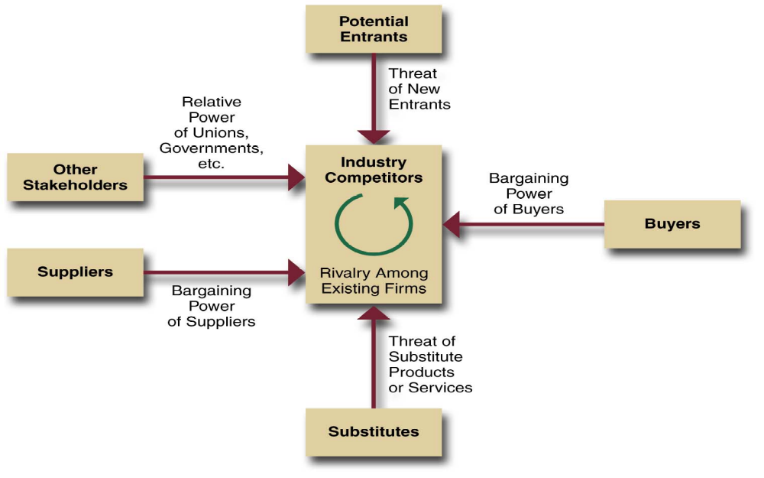
Industry Analysis: The Five Force Model

Slide 97
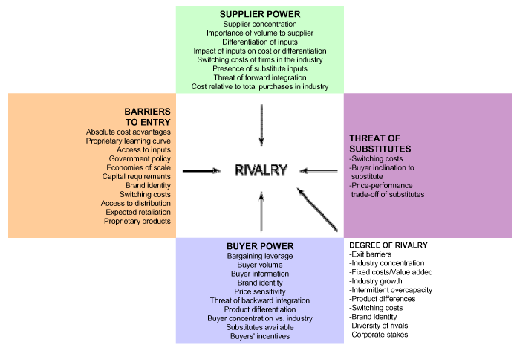

Slide 98
The purpose of Five-Forces Analysis
The five forces are environmental forces that impact on a company’s ability to compete in a given market.
The purpose of five-forces analysis is to diagnose the principal competitive pressures in a market and assess how strong and important each one is.

Slide 99
Porter’s Five Forces
Model of Competition
Threat of New Entrants
Threat of New Entrants
Notes:
11

Slide 100
Threat of New Entrants
Economies of Scale
Barriers to Entry
Product Differentiation
Capital Requirements
Switching Costs
Access to Distribution Channels
Cost Disadvantages Independent of Scale
Government Policy
Expected Retaliation
Notes:
12

Slide 101
Porter’s Five Forces
Model of Competition
Threat of New Entrants
Threat of New Entrants
Bargaining Power of Suppliers
Notes:
14

Slide 102
Bargaining Power of Suppliers
Suppliers are likely to be powerful if:
Supplier industry is dominated by a few firms
Suppliers exert power in the industry by:
Suppliers’ products have few substitutes
* Threatening to raise
prices or to reduce quality
Buyer is not an important customer to supplier
Powerful suppliers can squeeze industry profitability if firms are unable to recover cost increases
Suppliers’ product is an important input to buyers’ product
Suppliers’ products are differentiated
Suppliers’ products have high switching costs
Supplier poses credible threat of forward integration
Notes:
15

Slide 103
Porter’s Five Forces
Model of Competition
Threat of New Entrants
Threat of New Entrants
Bargaining Power of Suppliers
Bargaining Power of Buyers
Notes:
17

Slide 104
Bargaining Power of Buyers
Buyer groups are likely to be powerful if:
Buyers are concentrated or purchases are large relative to seller’s sales
Buyers compete with the supplying industry by:
Purchase accounts for a significant fraction of supplier’s sales
Products are undifferentiated
* Bargaining down prices
Buyers face few switching costs
* Forcing higher quality
Buyers’ industry earns low profits
* Playing firms off of
each other
Buyer presents a credible threat of backward integration
Product unimportant to quality
Buyer has full information
Notes:
18

Slide 105
Porter’s Five Forces
Model of Competition
Threat of New Entrants
Threat of New Entrants
Bargaining Power of Suppliers
Bargaining Power of Buyers
Threat of Substitute Products
Notes:
20

Slide 106
Threat of Substitute Products
Keys to evaluate substitute products:
Products with similar function limit the prices firms can charge
Products with improving price/performance tradeoffs relative to present industry products
Example:
Electronic security systems in place of security guards
Fax machines in place of overnight mail delivery
Notes:
21

Slide 107
Porter’s Five Forces
Model of Competition
Threat of New Entrants
Threat of New Entrants
Bargaining Power of Suppliers
Rivalry Among Competing Firms in Industry
Bargaining Power of Buyers
Threat of Substitute Products
Notes:
23

Slide 108
Rivalry Among Existing Competitors
Intense rivalry often plays out in the following ways:
Jockeying for strategic position
Using price competition
Staging advertising battles
Increasing consumer warranties or service
Making new product introductions
Occurs when a firm is pressured or sees an opportunity
Price competition often leaves the entire industry worse off
Advertising battles may increase total industry demand, but may be costly to smaller competitors
Notes:
25

Slide 109
Rivalry Among Existing Competitors
Cutthroat competition is more likely to occur when:
Numerous or equally balanced competitors
Slow growth industry
High fixed costs
High storage costs
Lack of differentiation or switching costs
Capacity added in large increments
Diverse competitors
High strategic stakes
High exit barriers
Notes:
26

Slide 110
The Five Forces are Unique to Your Industry
Five-Forces Analysis is a framework for analyzing a particular industry.
  Yet, the five forces affect all the other businesses in that industry.

Slide 111
Porter’s Approach to Industry Analysis
Assess the six forces --
    Threat of new entrants
    Rivalry among existing firms
    Threat of substitute products
    Bargaining power of buyers
    Bargaining power of suppliers
    Relative power of other stakeholders

Slide 112
Porter’s approach:
Threat of New Entrants --
  Barriers to entry:
    Economies of Scale
    Product Differentiation
    Capital Requirements
    Switching Costs
    Access to Distribution Channels
    Cost Disadvantages Independent of Size
    Government Policy

Slide 113
Porter’s approach:
Threat of Substitute Products/Services
  Substitute Products:
  Those products that appear to be different but can satisfy the same need as another product. To the extent that switching costs are low, substitutes can have a strong effect on an industry.

Slide 114
Porter’s approach:
Bargaining Power of Buyers --
  Buyer is powerful when:
    Buyer purchases large proportion of seller’s products
    Buyer has the potential to integrate backward
    Alternative suppliers are plentiful
    Changing suppliers costs very little
    Purchased product represents a high percentage of a buyer’s costs
    Buyer earns low profits
    Purchased product is unimportant to the final quality or price of a buyer’s products

Slide 115
Porter’s approach:
Bargaining Power of Suppliers --
  Supplier is powerful when:
    Supplier industry is dominated by a few companies but sells to many
    Its product is unique and/or has high switching costs
    Substitutes are not readily available
    Suppliers are able to integrate forward and compete directly with present customers
    Purchasing industry buys only a small portion of the supplier’s goods.

Slide 116
Supplier industry is dominated by a few firms
Suppliers’ products have few substitutes
Buyer is not an important customer to supplier
Suppliers’ product is an important input to buyers’ product
Suppliers’ products are differentiated
Suppliers’ products have high switching costs
Supplier poses credible threat of forward integration

Slide 117
Porter’s approach:
Rivalry Among Existing Firms --
  Intense rivalry related to:
    Number of competitors
    Rate of Industry Growth
    Produce or Service Characteristics
    Amount of Fixed Costs
    Capacity
    Height of Exit Barriers
    Diversity of Rivals

Slide 118
Industry Evolution (Industry Life-Cycle)
  Fragmented Industry –
  No firm has large market share and each firm serves only a small piece of the total market in competition with others.
  Consolidated Industry –
  Dominated by a few large firms, each of which struggles to differentiate its products from the competition.

Slide 119
Continuum of International Industries
Multidomestic
Industry in which companies tailor their products to the specific needs of consumers in a particular country.
Retailing
Insurance
Banking
Global
  Industry in which companies
  manufacture and sell the same products, with only minor adjustments made for individual countries around the world.
  Automobiles
  Tires
  Television sets

Slide 120
International / Global Industries
An industry is primarily multidomestic or primarily global based on two dimensions:
  Pressure for coordination
      Within the multinationals in that industry
  Pressure for local responsiveness
      Individual country markets

Slide 121
Strategic Groups and Strategic Types
Strategic Groups
A set of business units or firms that pursue similar strategies with similar resources.
Strategic Types
Category of firms based on a common strategic orientation and a combination of structure, culture, and processes consistent with that strategy.

Slide 122
Strategic Types
Categorized by one of four general strategic orientations:
Defenders
  Companies with a limited product line; focus on improving efficiency of current operations
Prospectors:
  Companies with fairly broad product lines; focus on product innovation and market opportunities.
Analyzers:
  Corporations that operate in at least two different product-market areas – one stable and one variable.
Reactors:
  Corporations that lack a consistent strategy-structure-culture relationship.

Slide 123
Forecasting Techniques
Extrapolation
Brainstorming
Expert opinion
Statistical modeling
Scenario writing

Slide 124
Porters five forces model:
POTENTIAL ENTRANTS
Threat of new entrants
Bargaining Power of Suppliers.
INDUSTRY
COMPETITORS
Rivalry Among
Existing Firms
SUPPLIERS
BUYERS
Bargaining Power of Buyers
Threat of Substitute products or services
SUBSTITUTES

Slide 125
Forces Driving Industry Competition
Factors Influencing Intensity of Inter-firm Rivalry
Numerous or equally balance competitors
Slow industry growth
High fixed or storage costs
Lack of Differentiation or switching costs
Capacity augmentation in large increments
Diverse competitors
High strategic stakes
High exit barriers

Slide 126
Factors Influencing Bargaining Power of Buyers:
A buyer group is powerful if:
1) It is concentrated
2) It purchases large volumes relative to the volume of firm’s sales
3) The products are standard or undifferentiated
4) Buyer face high switching costs
5) Buyer ears low profits
6) buyer poses threat of backward integration
7) Product is unimportant to buyer’s product/service
8) Buyer has full information

Slide 127
Factors Influencing Bargaining Power of Suppliers:
A supplier group is powerful if:
1) It is dominated by a few companies and is more concentrated than industry buying group
2) It is not threatened by substitute products
3) The buyer industry is not an important customer
4) The product is an important input for customer
5) Product is differentiated or has built in switching costs
6) Supplier poses threat of forward integration

Slide 128
Factors Influencing Threats to Potential Entrants:
Economics of scale
Product differentiation
Capital requirements
Switching costs
Access to distribution channels
Proprietary product technology
Favored access to raw materials
Favorable location
Government subsidy and government policy
Learning or experience curves
Retaliation practices

Slide 129
Factors Influencing Threats of Substitutes:
Substitutions are products, services, materials, or processes
which perform the same function as the those of the industry, but
are not direct industry rivals. Substitutes are the greatest threats if
they constitute,
1) radical innovations which foster displacement or obsolescence;
2) substitutes which respond to trends and improve their price performance relative to tradeoffs with the industry product; and
3) substitutes produced by industries earning high profits.

Slide 130
Design expertise important in fashion and apparel industries
Short delivery time capability
Supply chain management capabilities
Strong e-commerce capabilities a user friendly web site and or skills in using internet technology applications to streamline internal operations

Slide 131
Other types KSF
Overall low costs not just in manufacturing so as to be able to meet low price expectations of customers
Convenient locations important in many retailing business
Ability to provide fast convenient after the sale repairs and services
A strong balance sheet and access to financial capital important in newly emerging industries with high degrees of business risk and in capital intensive industries
Patent protection

